Slide 1
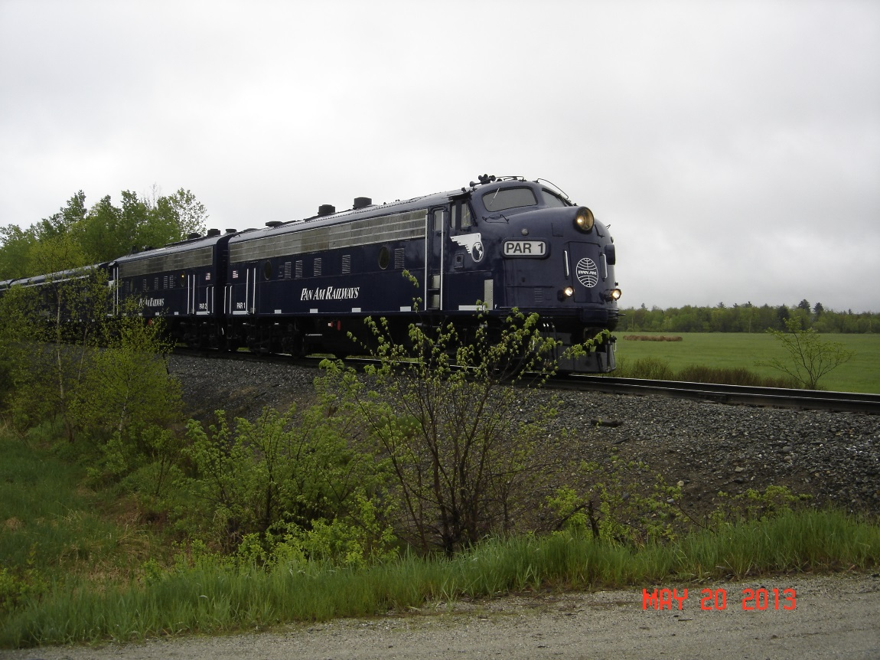
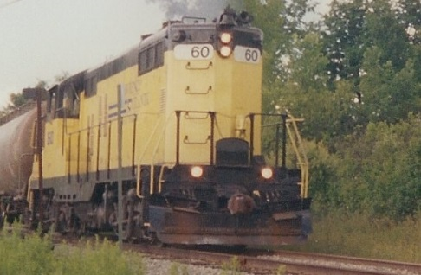
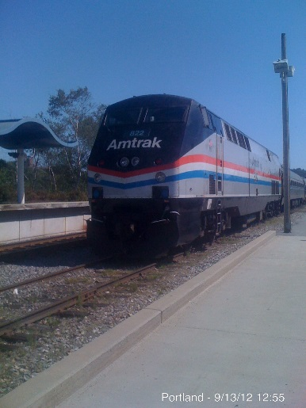
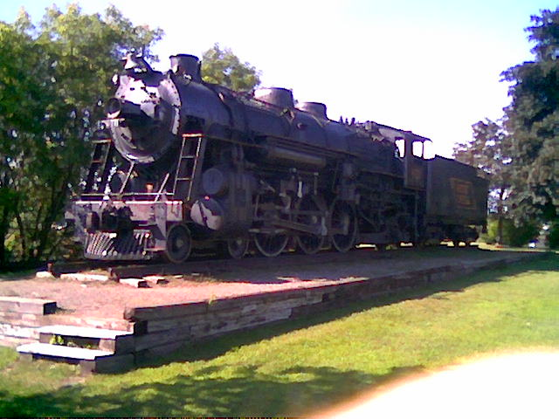
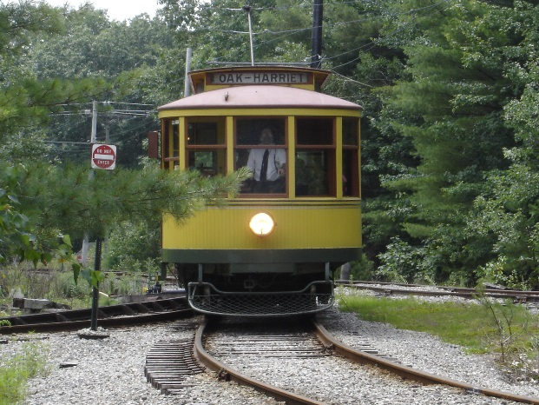
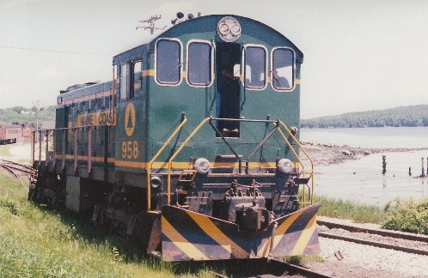
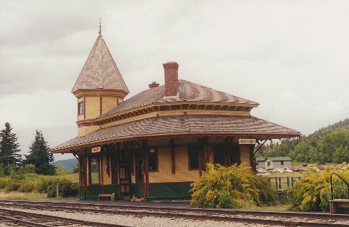
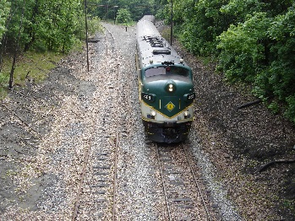
Railroads of Southern Maine
A Railfan’s Guide to the Railroads of Southern Maine

Slide 2
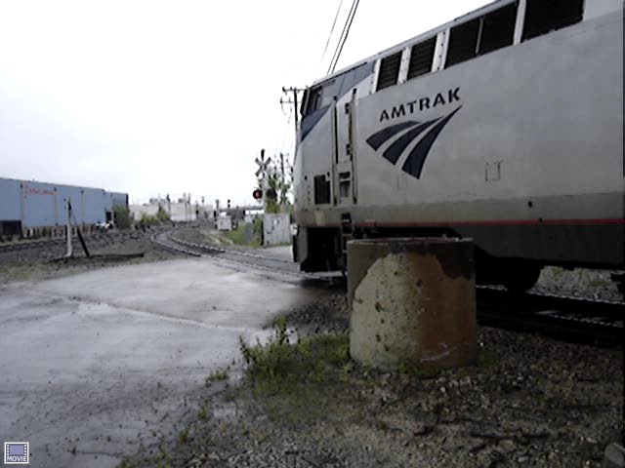
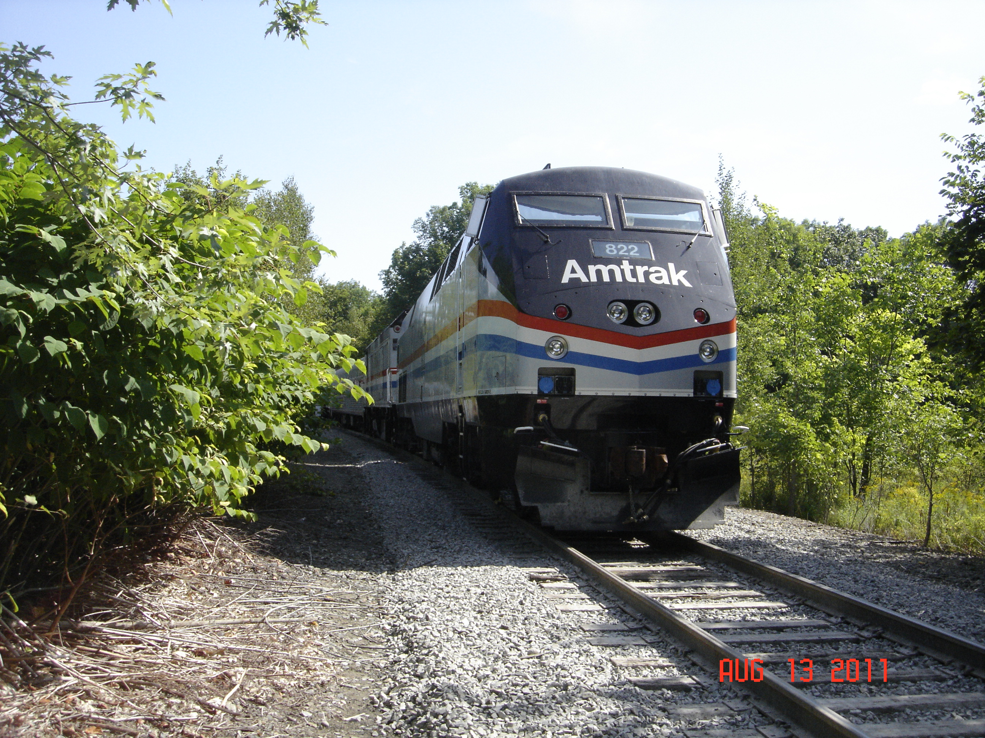
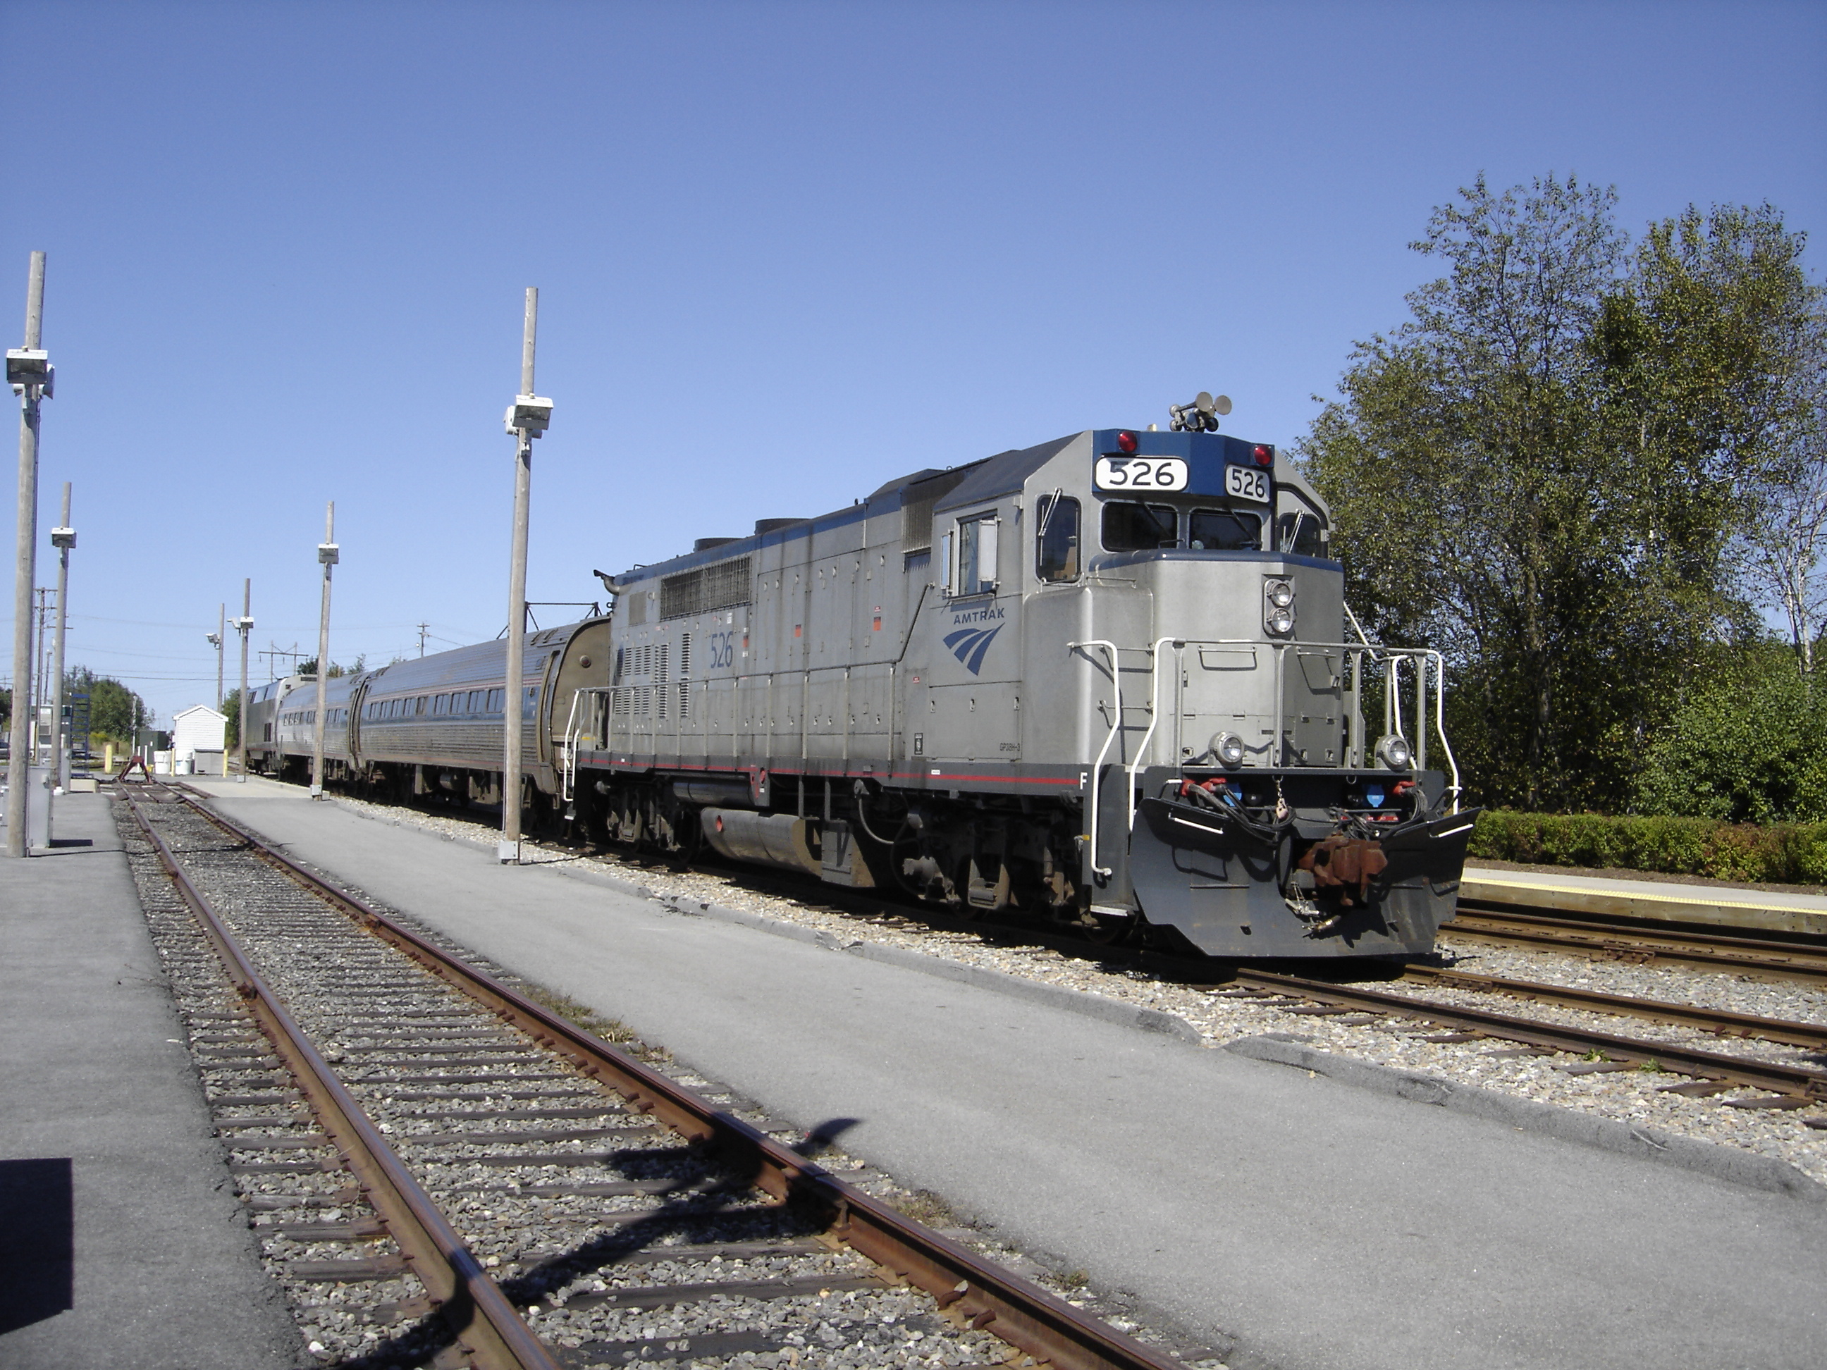
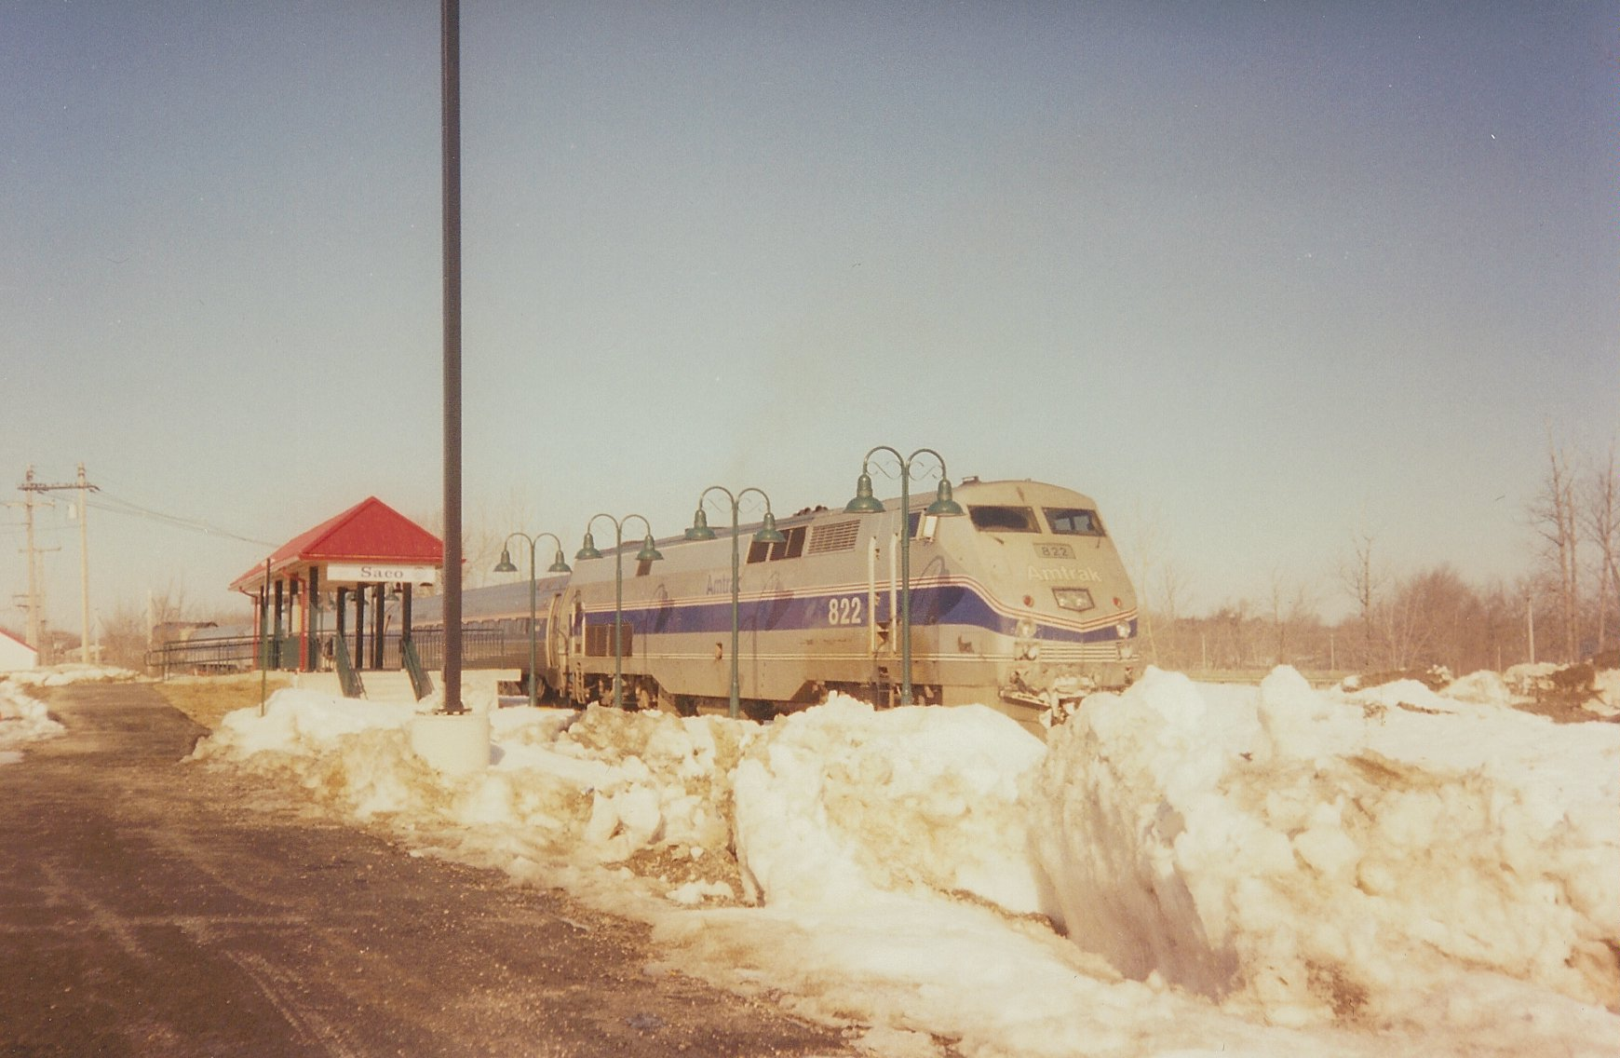
Amtrak
(AMTK)

Slide 3
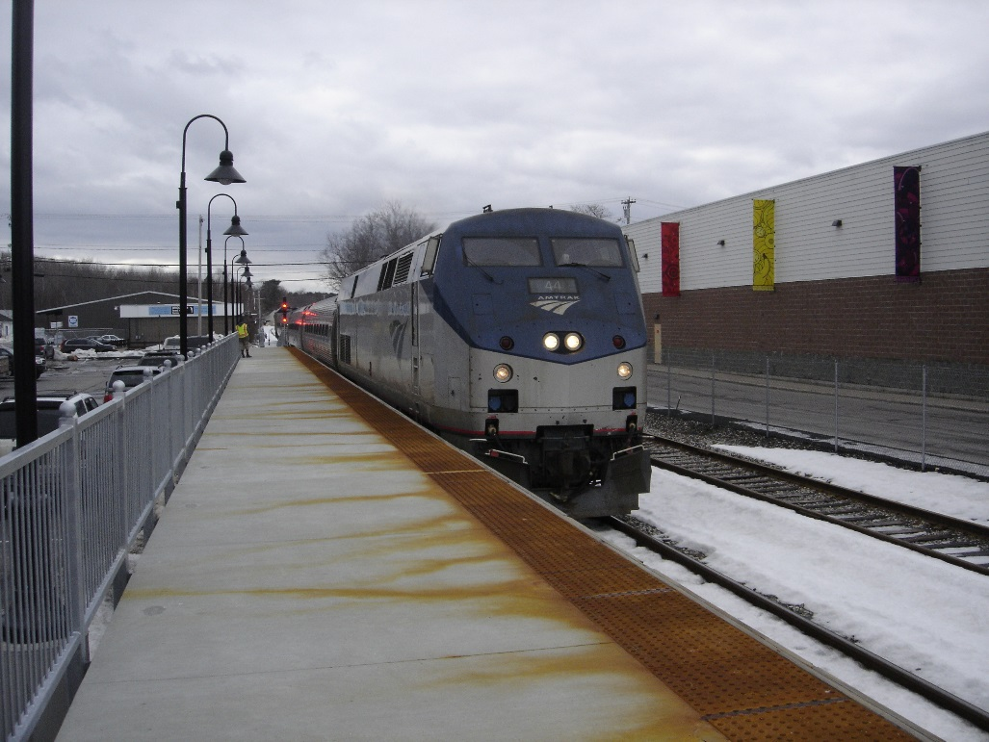
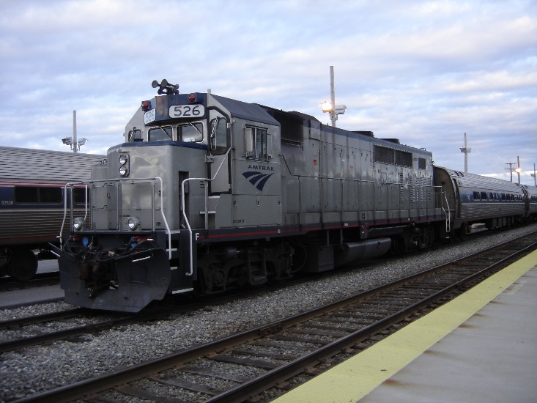
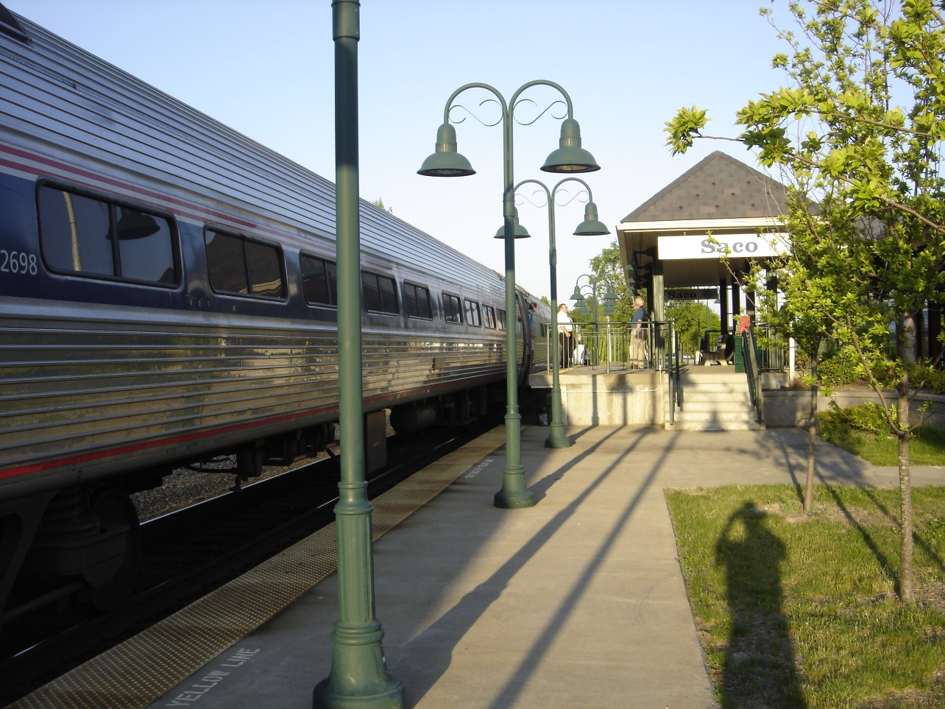
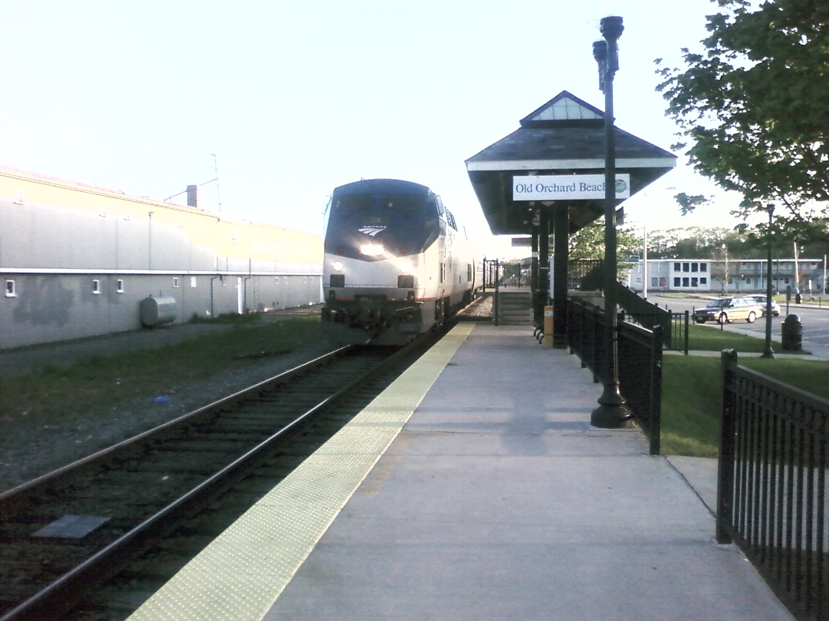
Amtrak Stations

Slide 4
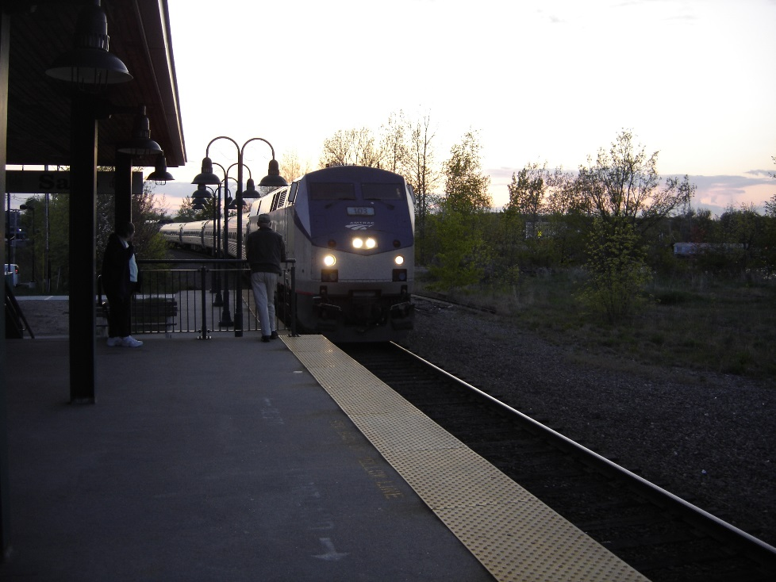
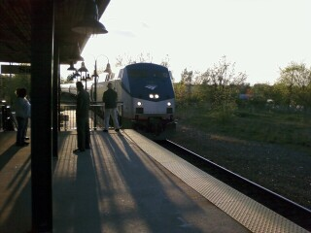
Saco
43°29'46.2"N 70°26'57.0"W

Slide 5
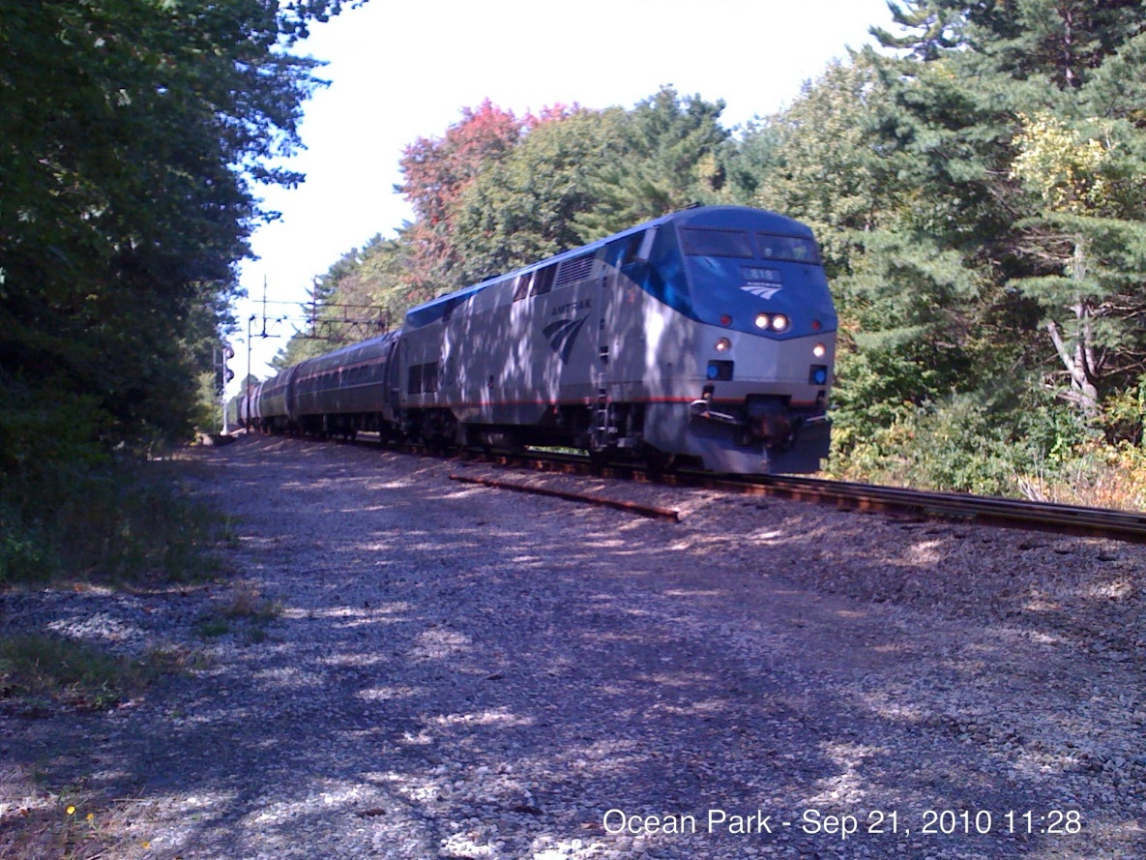
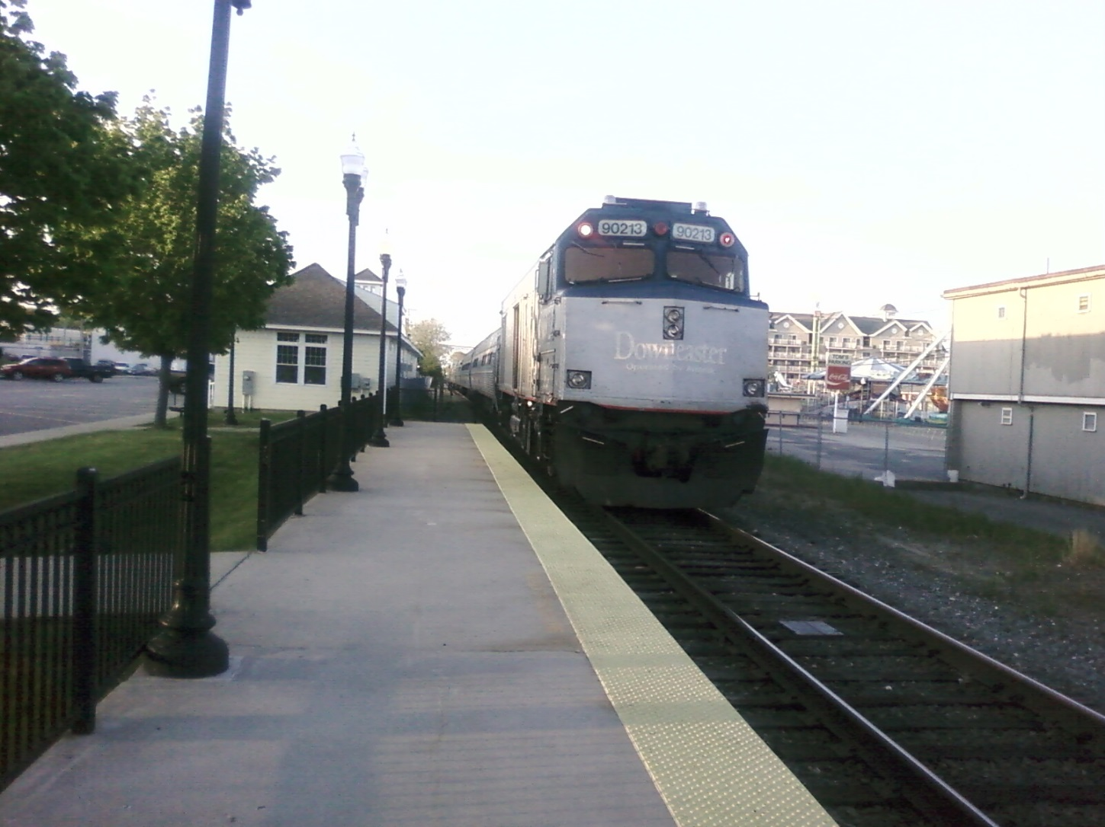
Old Orchard Beach
43°30'51.5"N 70°22'34.4"W

Slide 6
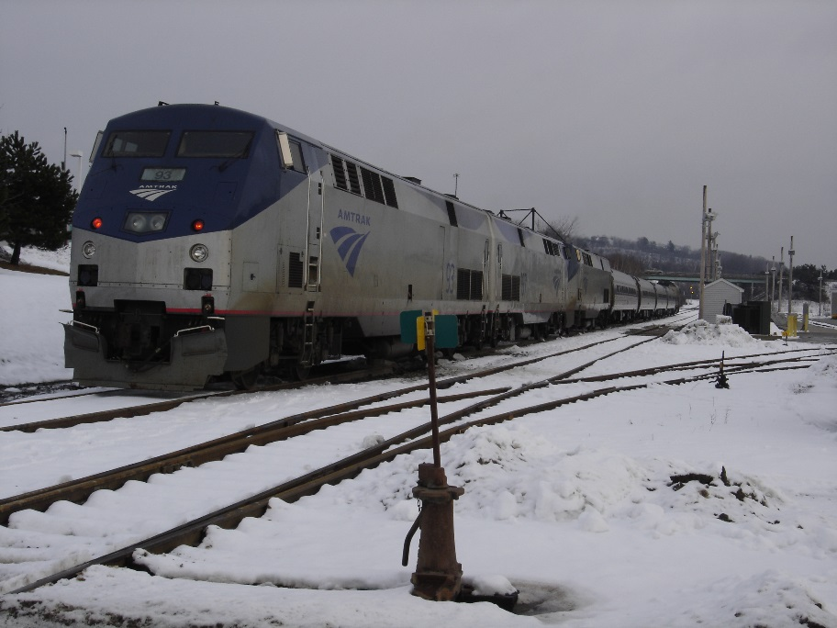
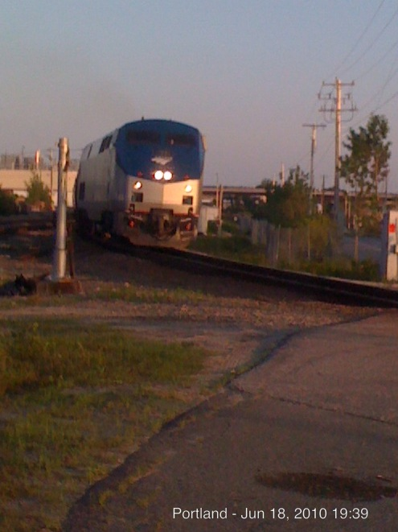
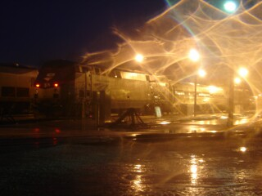
Portland
Mountain Junction
43°39'11.0"N 70°17'26.8"W
43°38'52.4"N 70°16'47.3"W

Slide 7
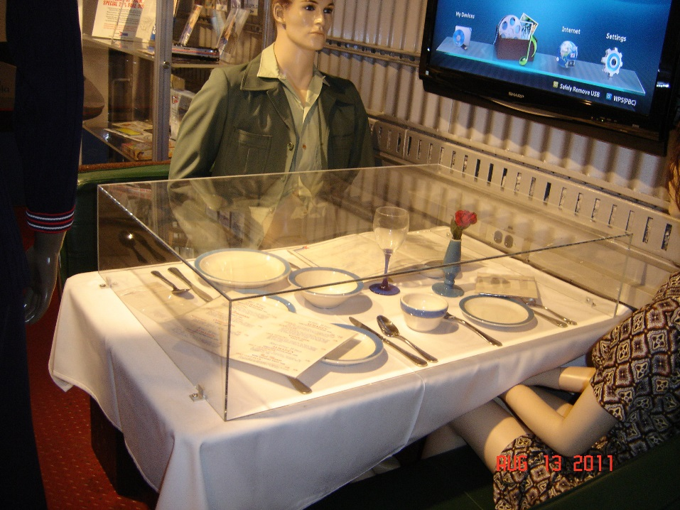
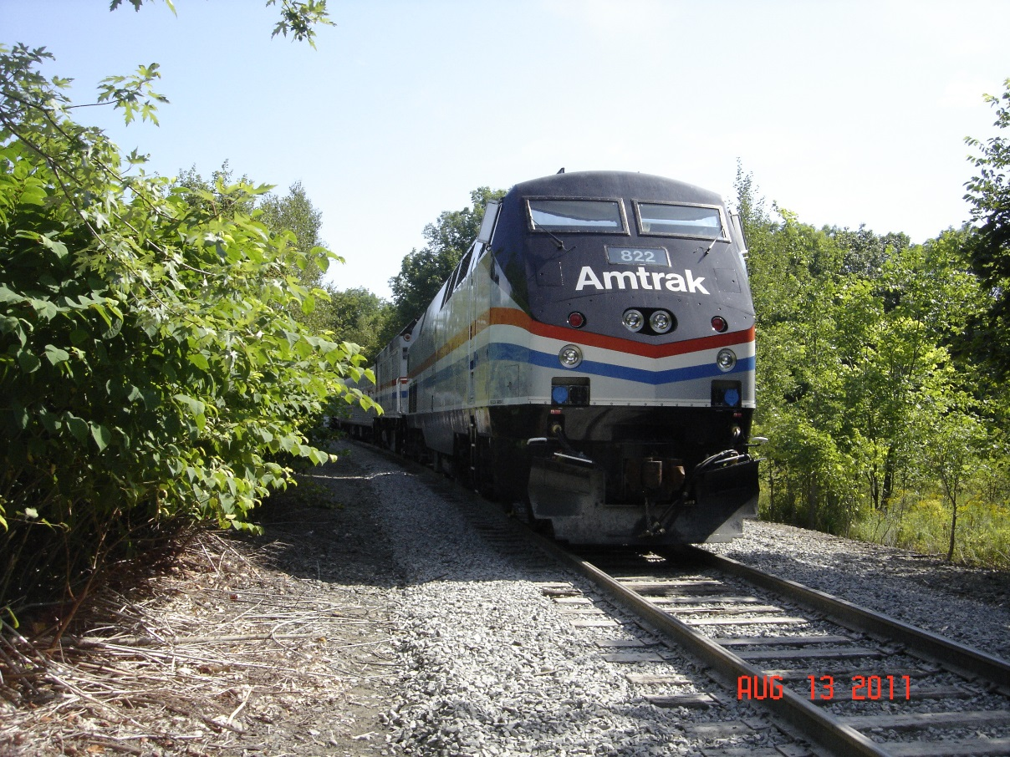
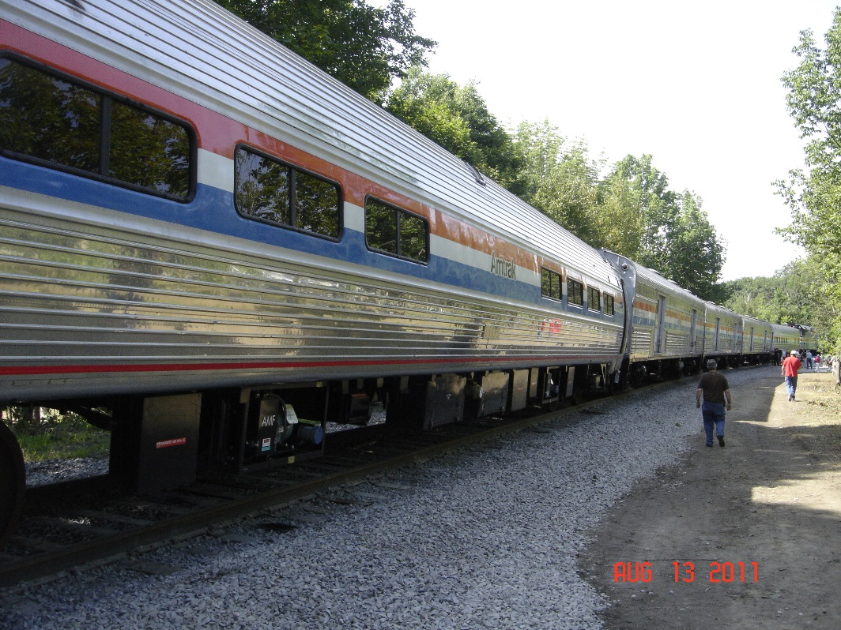
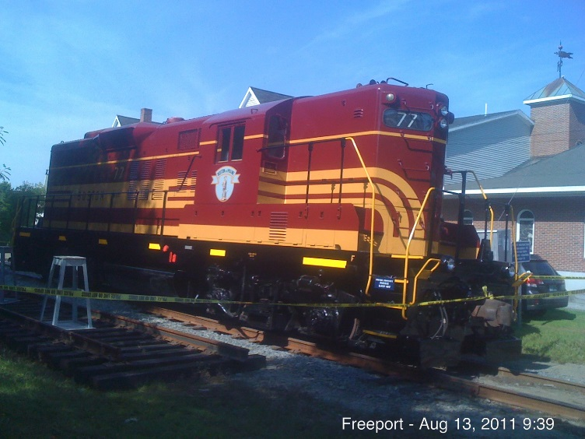
Freeport
43°51'18.5"N 70°06'07.8"W

Slide 8
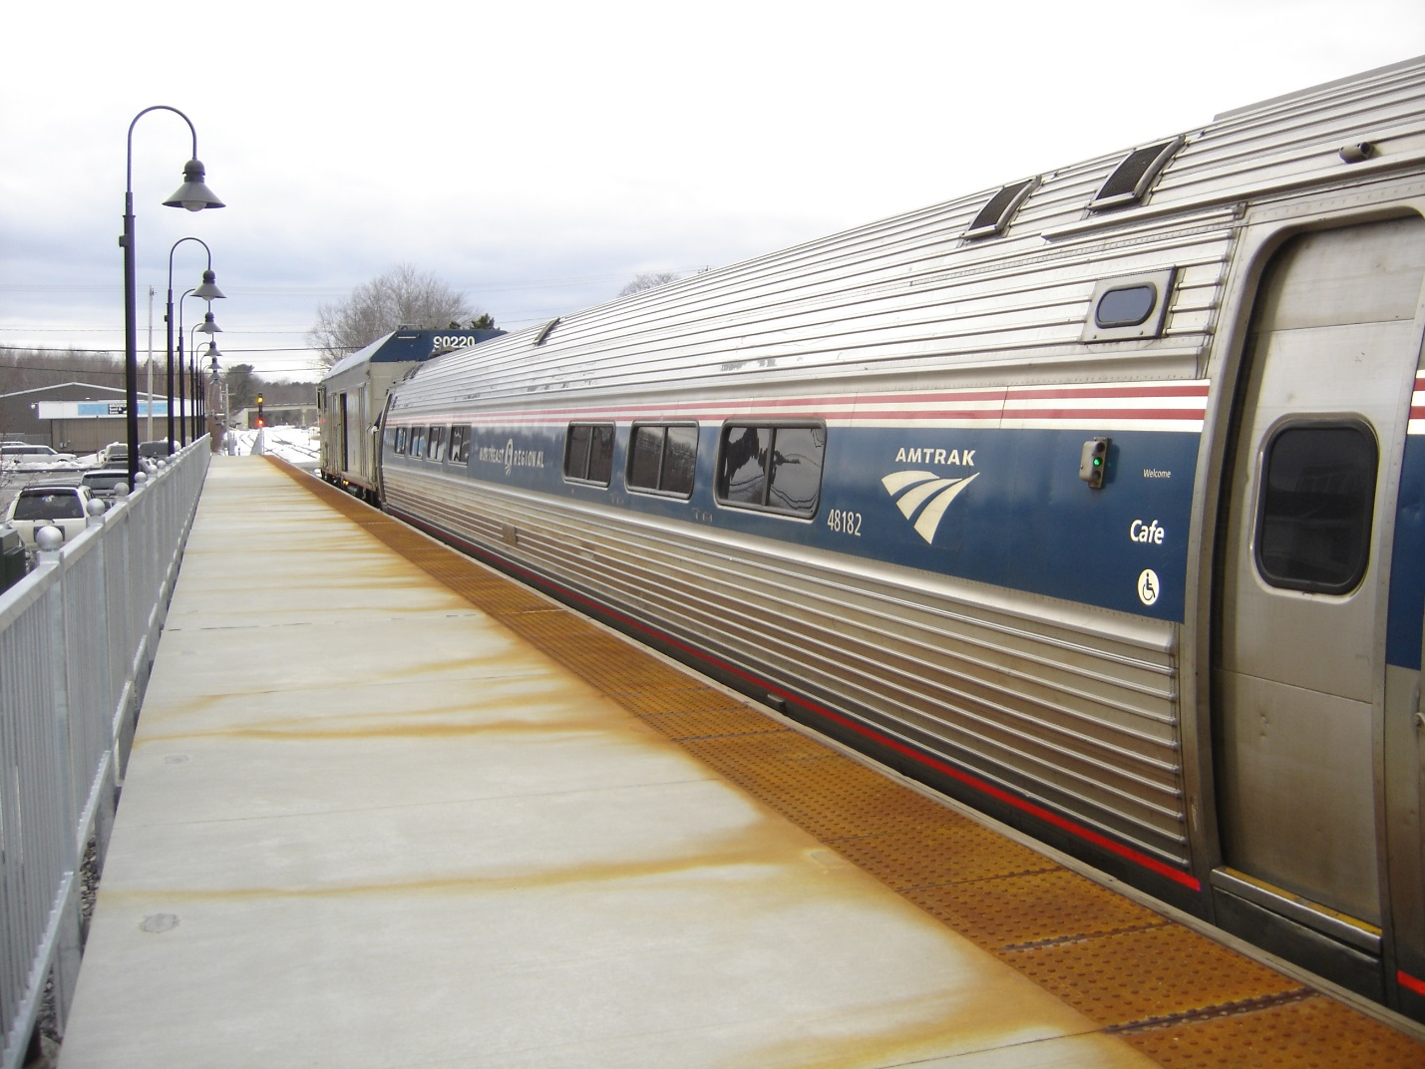
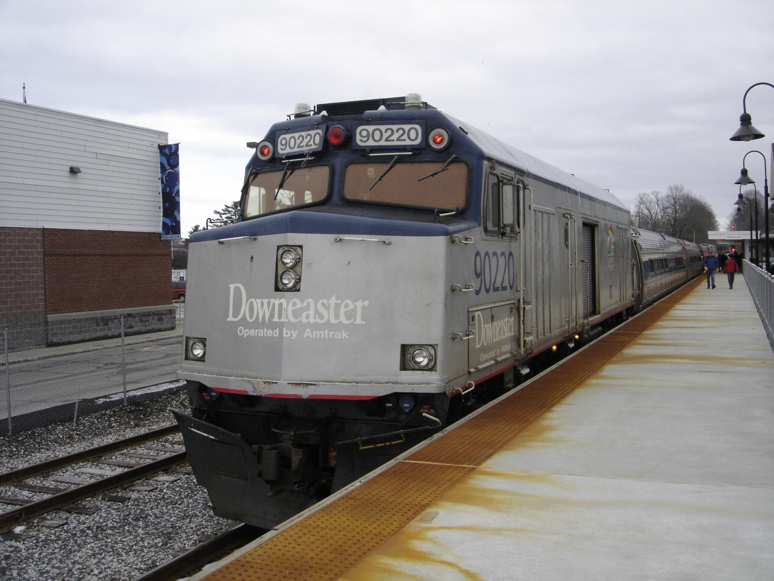
Brunswick
43°54'41.6"N 69°57'56.2"W

Slide 9
Cooks, Scarborough

Slide 10
Finding Cooks from Amtrak
1. Head north on Thompson's Point toward Fore River Parkway Trail drive 0.2 mi
2. Turn right onto Fore River Pkwy drive 256 ft.
3. Turn right to merge onto I-295 S drive 1.0 mi
4. Take exit 4 to merge onto U.S. 1 S toward Main St drive 2.7 mi
5. Turn left onto Pleasant Hill Rd drive 1.4 mi
6. Turn right to stay on Pleasant Hill Rd drive 0.2 mi
7. Continue onto Chamberlain Rd drive 0.6 mi
8. Continue onto Highland Ave
Destination will be on the right in 0.1 m
43°35'13.1"N 70°18'45.8"W

Slide 11
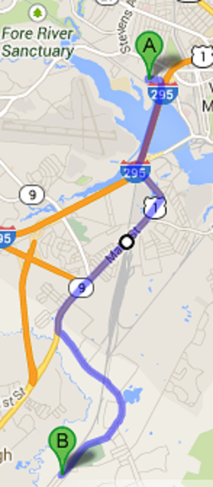
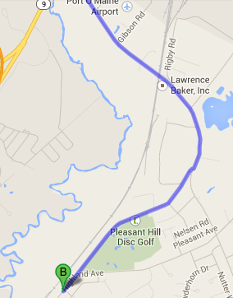
Finding Cooks from Amtrak

Slide 12
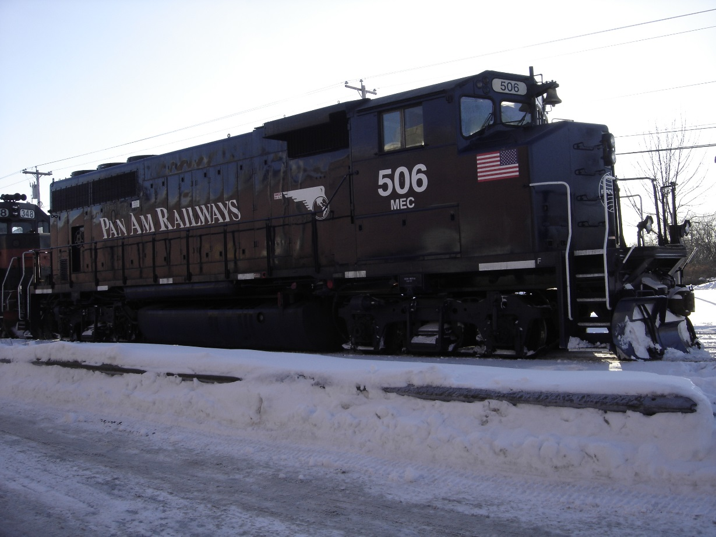
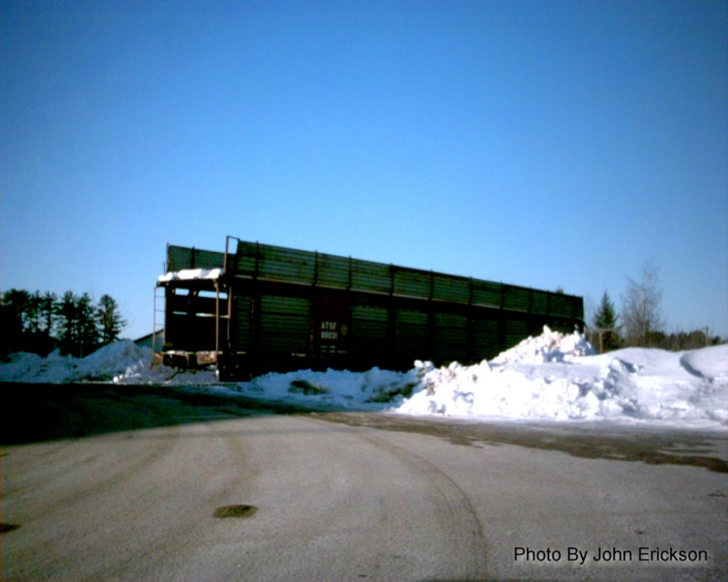
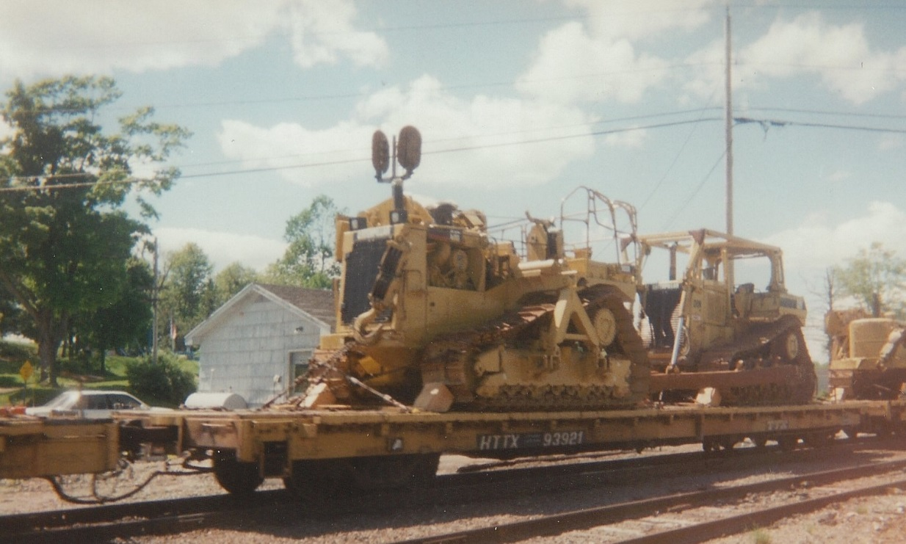
PanAm

Slide 13
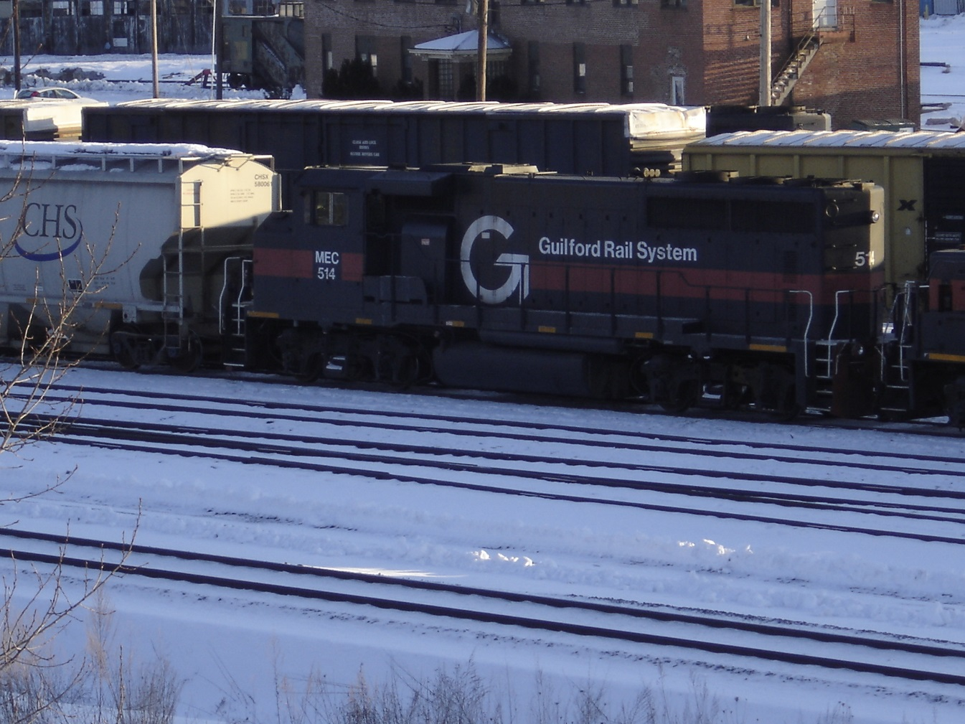
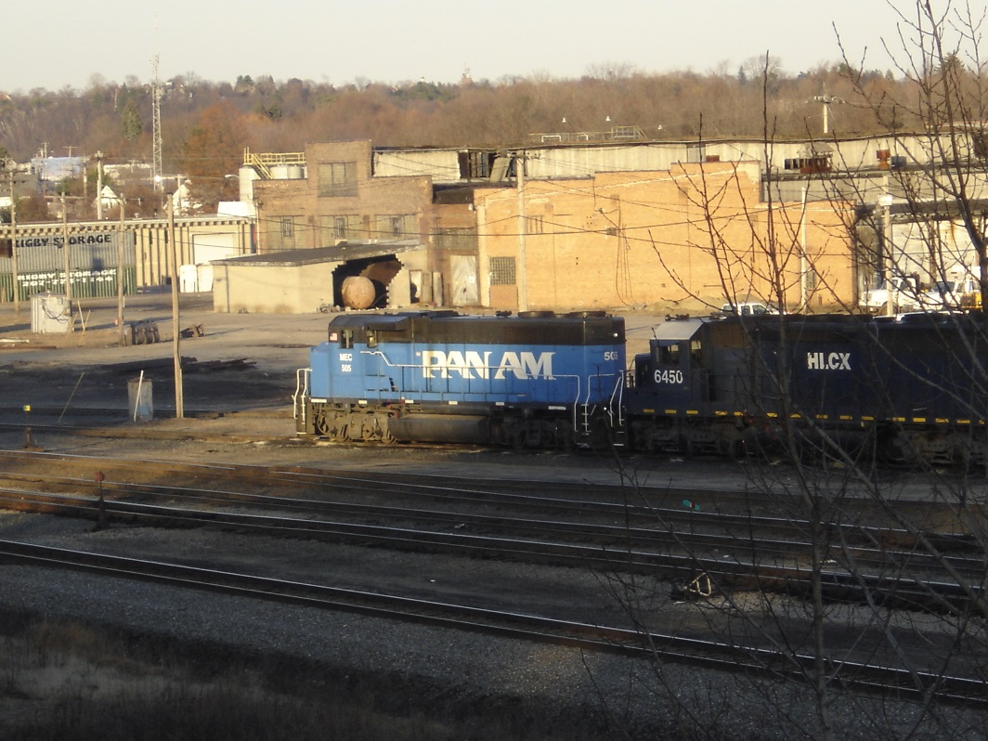
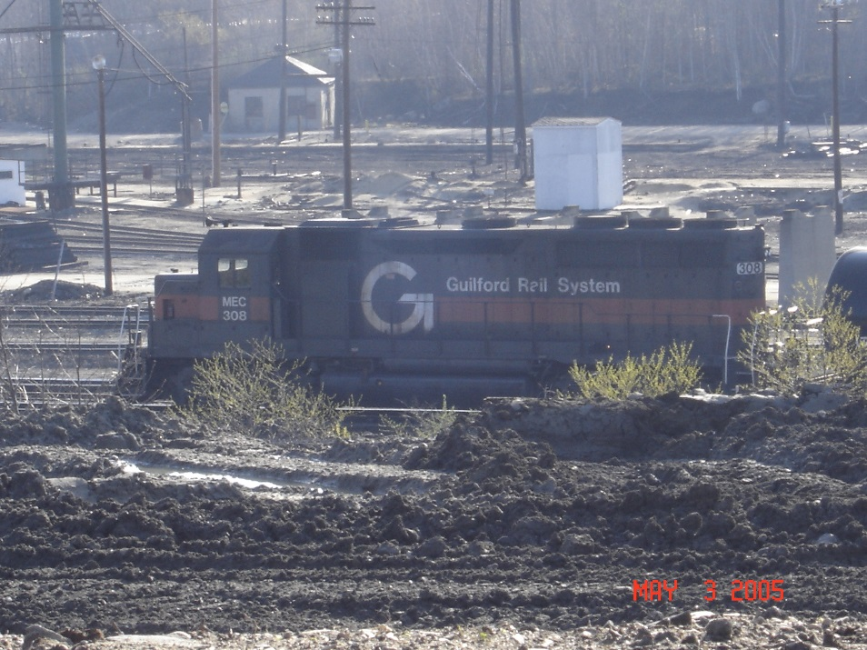
Rigby Yard, South Portland
43°37'24.2"N 70°17'54.4"W

Slide 14
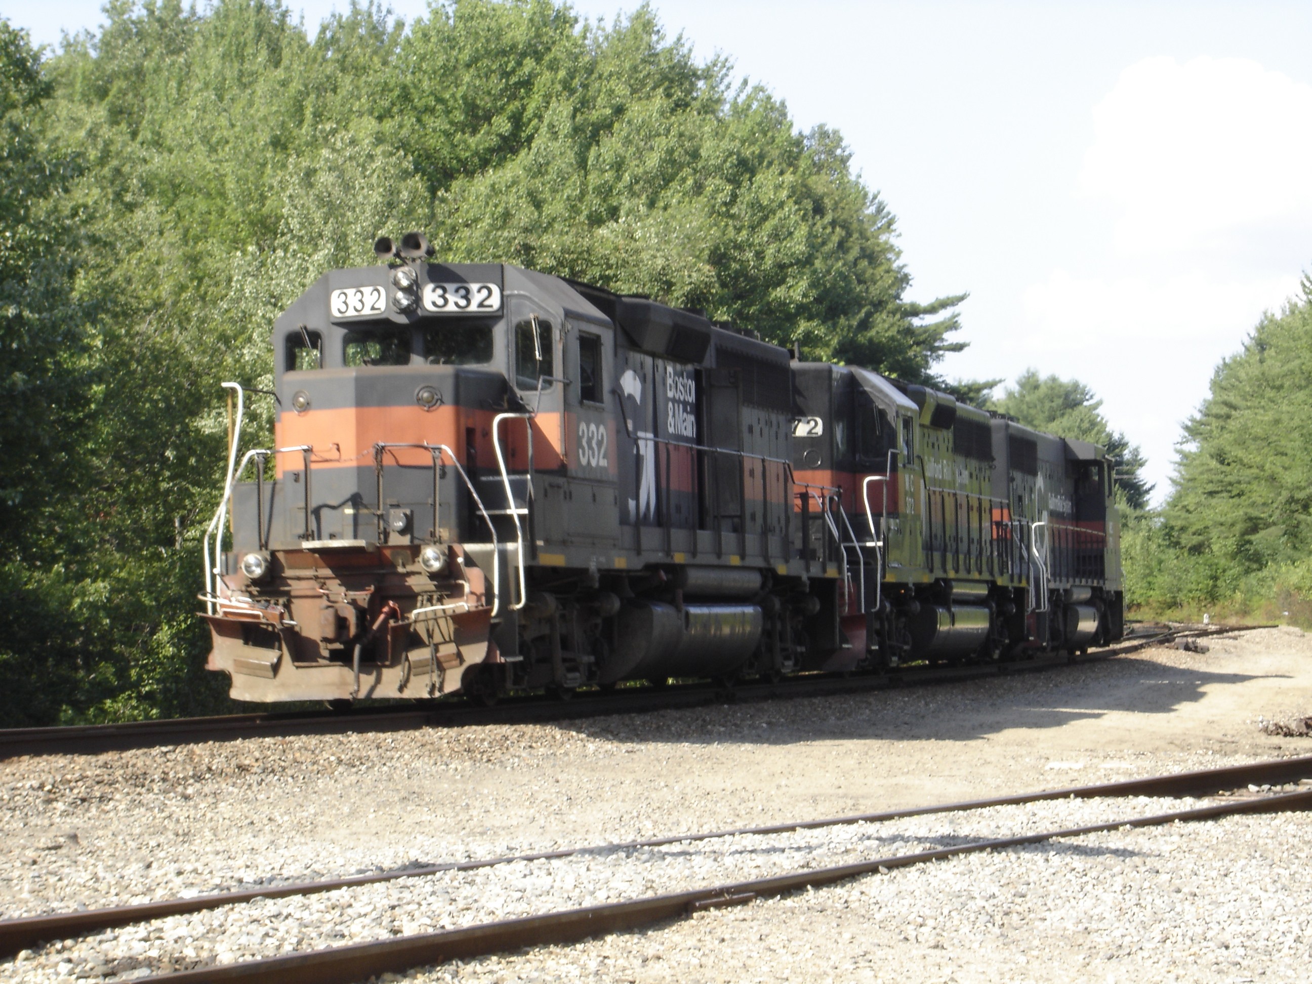
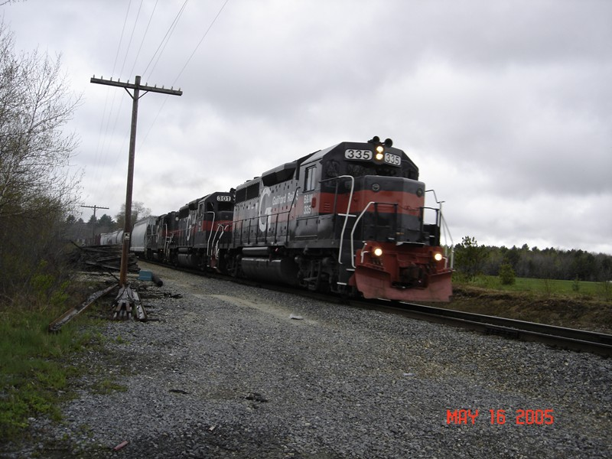
Royal Junction
43°47'54.9"N 70°13'24.5"W

Slide 15
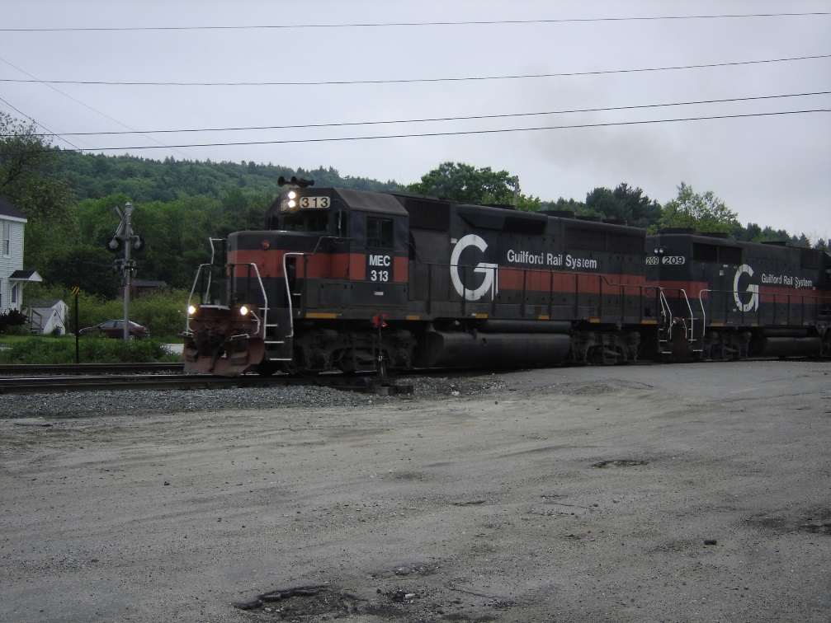
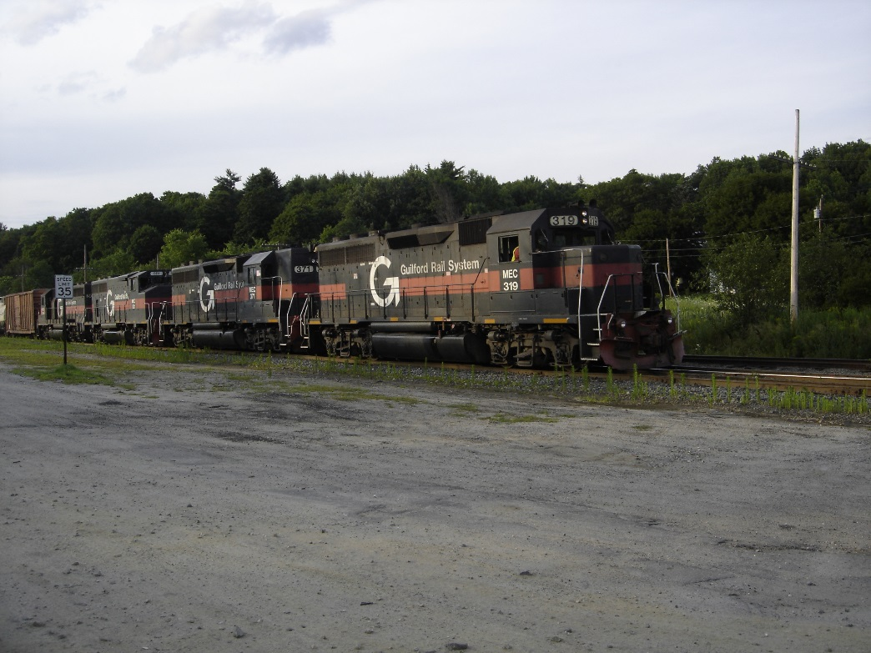
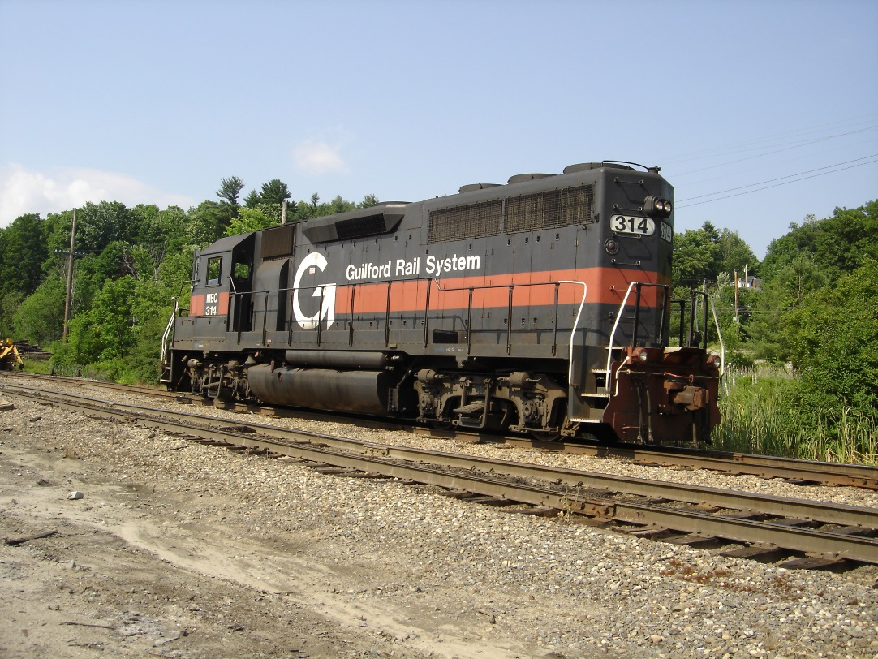
Danville, Auburn

Slide 16
Rigby To Danville
Head south on Sunset Ave toward Union St, 52 ft
Turn right onto Union St, 0.1 mi
Turn left onto Main St, 0.4 mi
Use the right lane to take the Maine Turnpike ramp to Interstate 95/Interstate 295, 194 ft
Follow I-95 N/Maine Turnpike to Auburn. Take exit 75 from I-95 N/Maine Turnpike, 30 min (32.0 mi)
Turn right onto ME-100 S/ME-4 S/US-202 W/Washington St S, 1.0 mi
Turn left onto Moose Brook Rd, 0.5 mi
Turn left onto Old Danville Rd, 0.2 mi
Turn right onto Dunlap St, 23 ft
Danville Junction is at 44°01'16.1"N 70°15'55.2"W

Slide 17
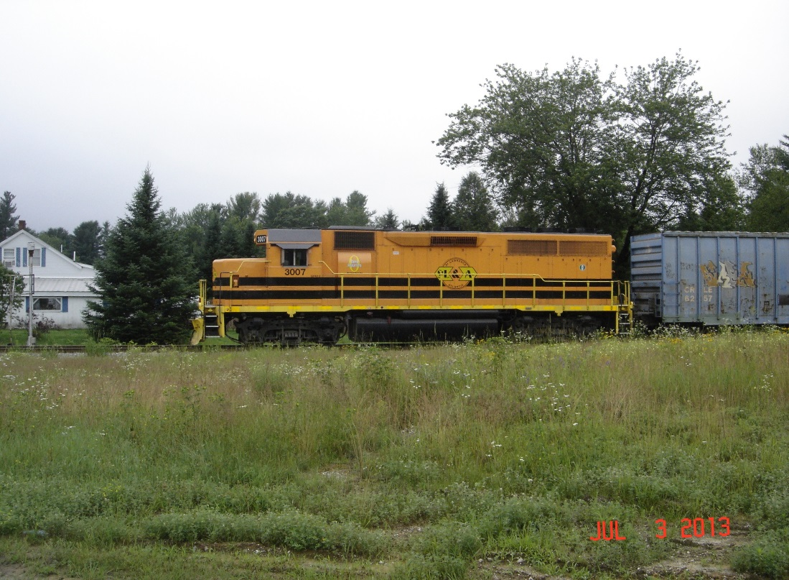
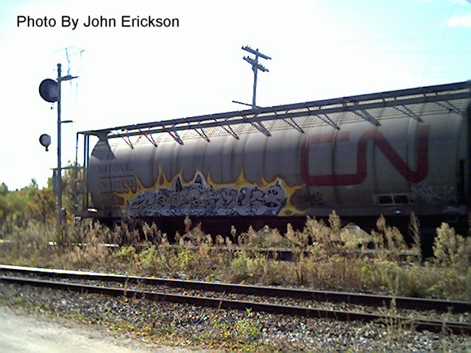
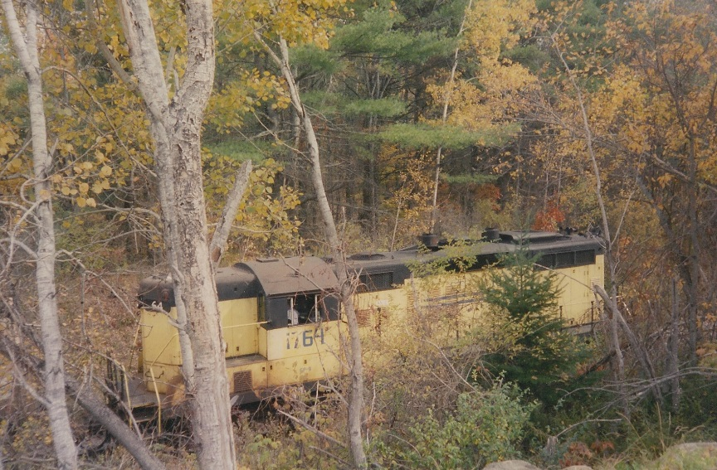
Saint Lawrence & Atlantic
Danville

Slide 18
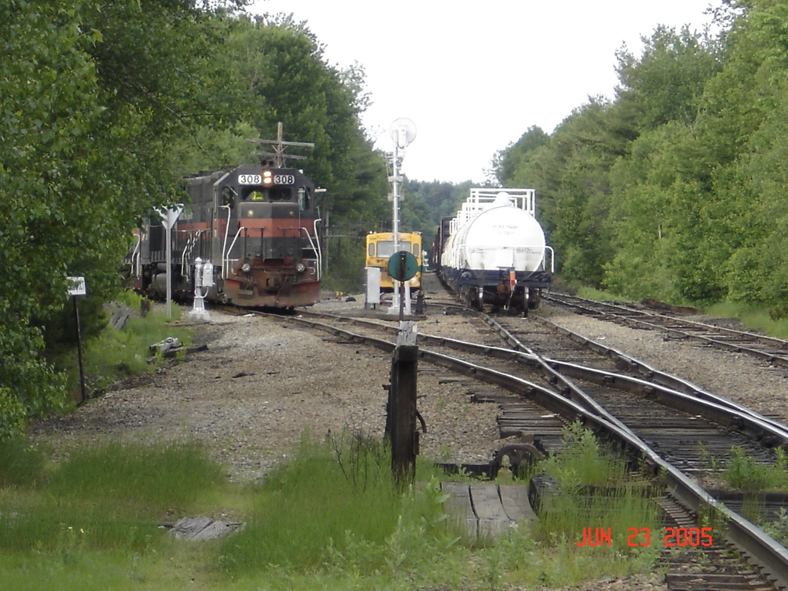
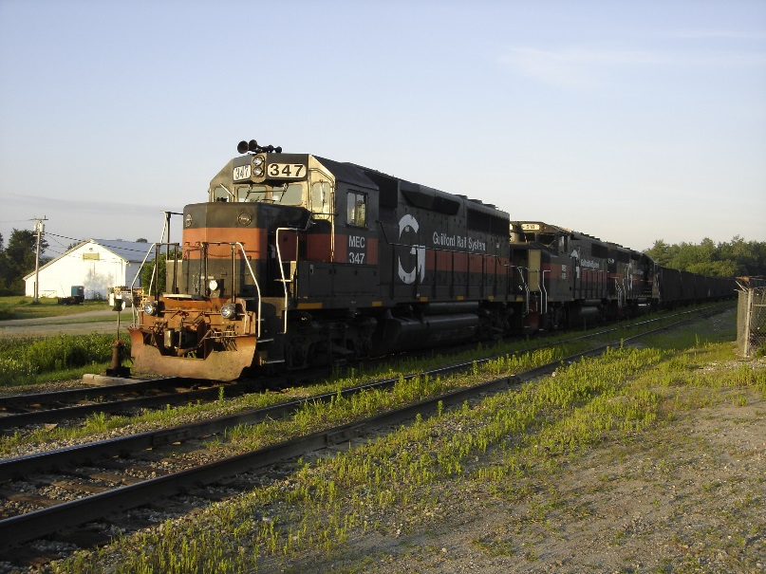
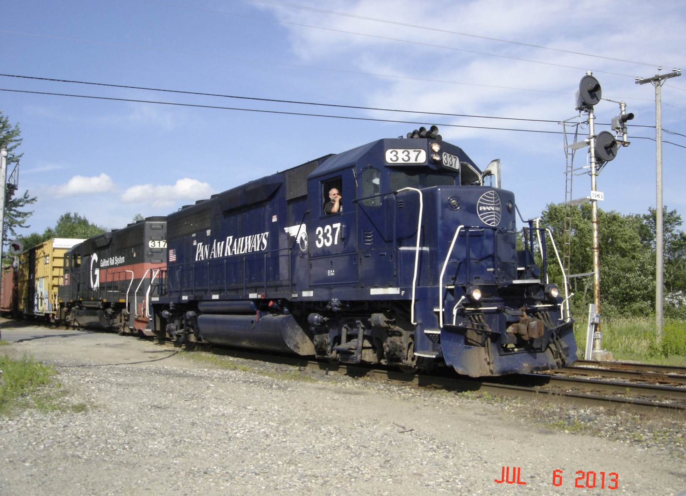
Leeds Junction
44°12'24.5"N 70°04'43.4"W

Slide 19
Danville to Leeds Jct.
Old Danville Rd
1. Head northeast on Old Danville Rd toward Grain Mill Rd 1.1 mi
2. Turn left onto Danville Corner Rd 0.6 mi
3. Take the 1st right onto Washington St N 3.7 mi
4. Continue onto Minot Ave 0.5 mi
5. Turn right onto ME-100 N/ME-11 N/US-202 E/Court St Continue to follow ME-100 N/ME-11 N/US-202 E 10.4 mi
6. Turn right onto Leeds Junction Rd 1.1 mi
7. Continue onto Greene Rd 0.3 mi
Leeds Junction Rd

Slide 20
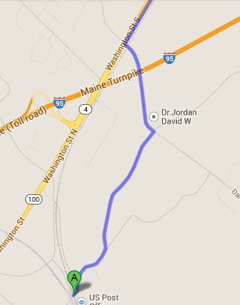
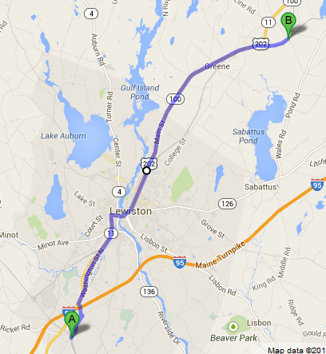
Danville to Leeds Jct.

Slide 21
Maine Eastern
Rockland
Fallen Flag
Brunswick

Slide 22
About Safety
Data from Operation Lifesaver at http://oli.org

Slide 23
Acknowledgements
Operation Lifesaver
http://oli.org/about-us/news/statistics/
Google maps
http://www.google.com/maps/

